Slide 1
Topic05.Feature reduction selection/extraction
資料科學 Data Science
張家銘 Jia-Ming Chang
政治大學資訊科學系
The slide isonly for educational purposes. If any infringement, please contact me and we will correct immediately.

Slide 2
Copyright declaration 版權說明
Some of the figures in this presentation are taken from "An Introduction to Statistical Learning, with applications in R" (Springer, 2013) with permission from the authors: G. James, D. Witten, T. Hastie and R. Tibshirani.
The web site of the book
The credit of individual is indicated in the bottom part of the slide.
ie.,

Slide 3

Copyright declaration 版權說明
Some of the figures in this presentation are taken from "Practical Data Science with R (Manning, 2019)”
The web site of the book
The credit of individual is indicated in the bottom part of the slide.
ie.,

Slide 4
Copyright declaration 版權說明
Some of the figures in this presentation are taken from "R for Data Science” under the Creative Commons Attribution-NonCommercial-NoDerivs 3.0 License.
The web site of the book
The credit of individual is indicated in the bottom part.
ie.,

Slide 5
Recap for the last week

Slide 6
Bias-variance decomposition
E[(y[i]-f(x[i,]))²] = bias² + variance + irreducibleError
Model bias : your chosen modeling technique will never get right
Model variance : your modeling technique gets wrong due to incidental relations in the data.
Irreducible error : truly unmodelable portion of the problem given the current variables

Slide 7
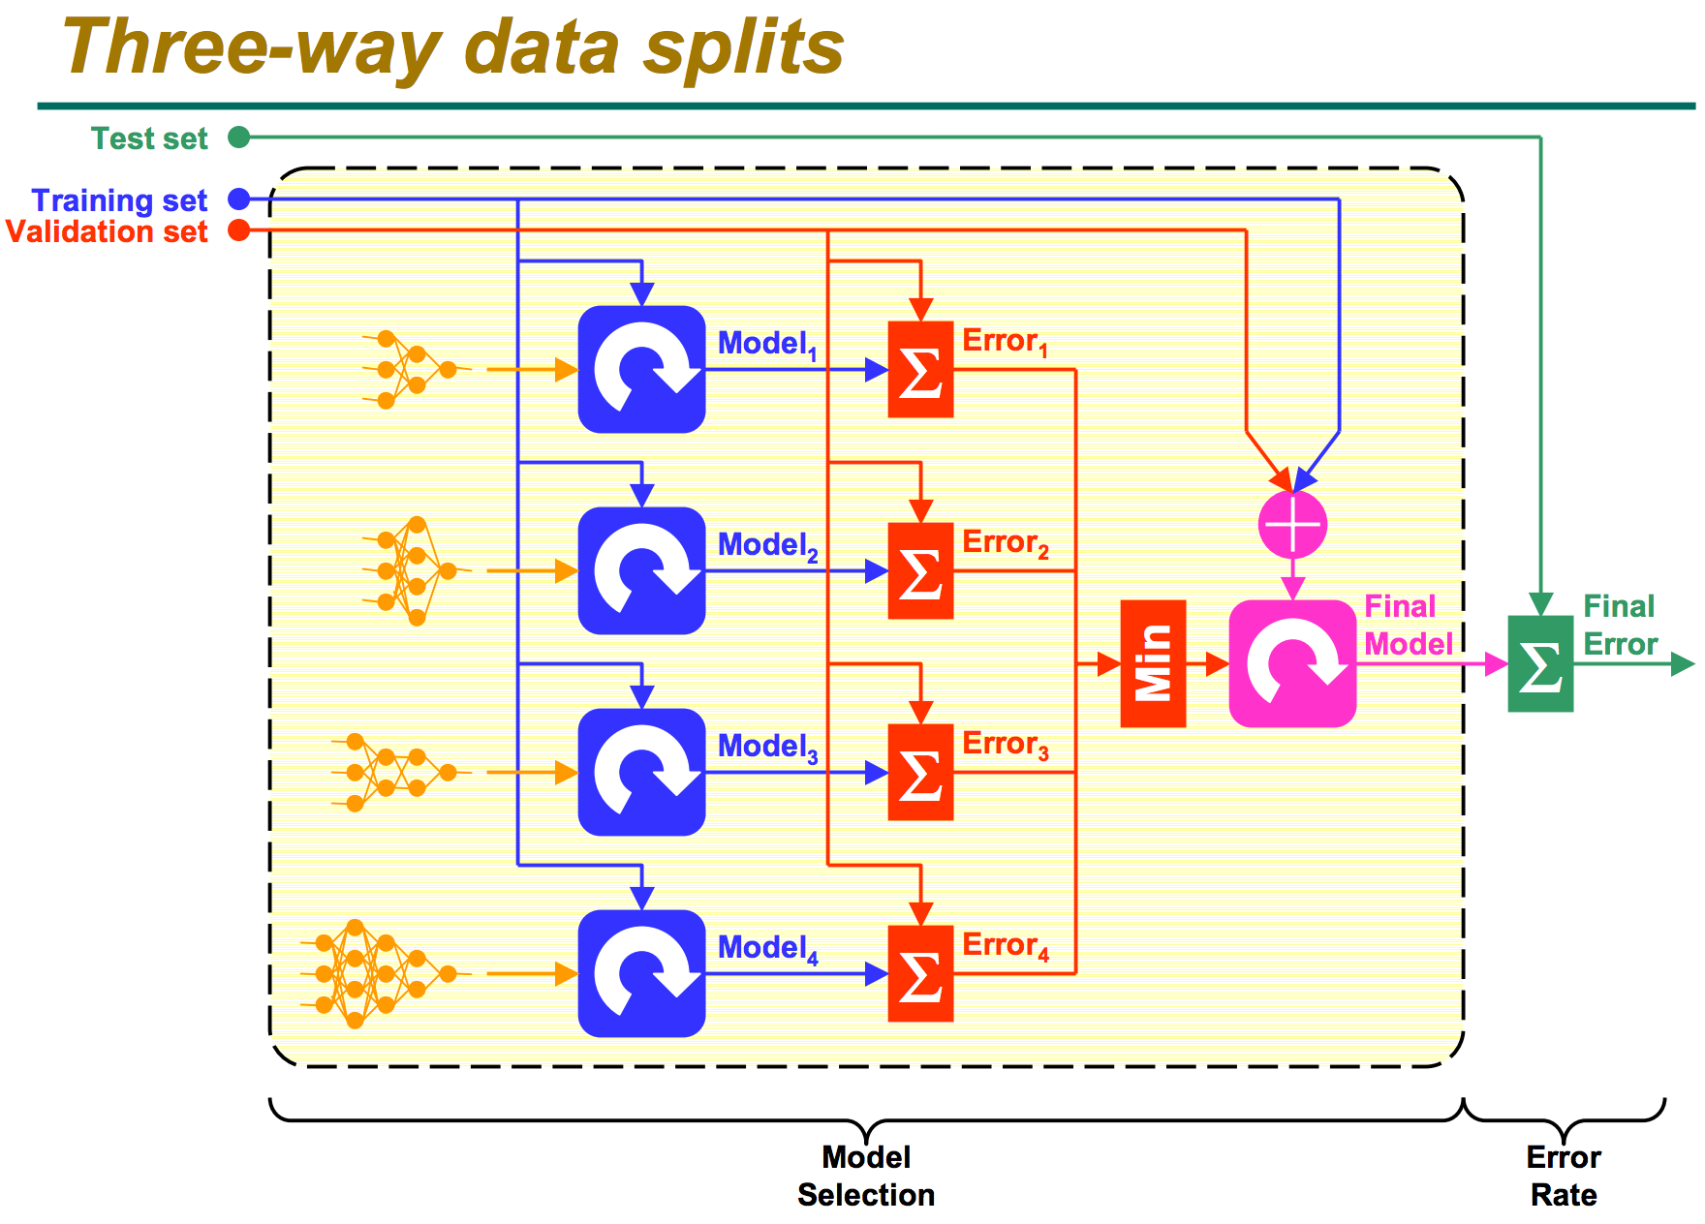
Three-way data splits
http://research.cs.tamu.edu/prism/lectures/iss/iss_l13.pdf

Slide 8
Summarizing R’s distribution naming conventions
dDIST(x, ...)
the distribution function (PDF) that returns the probability of observing the value x.
rDIST(n, ...)
the random number generation function that returns n values drawn from the distribution DIST.
qDIST(p, ...)
the quantile function that returns the x corresponding to the pth percentile of DIST.
pDIST(x, ...)
the cumulative distribution function (CDF) that returns the probability of observing a value less than x.
Practical Data Science with R by Nina Zumel, John Mount

Slide 9
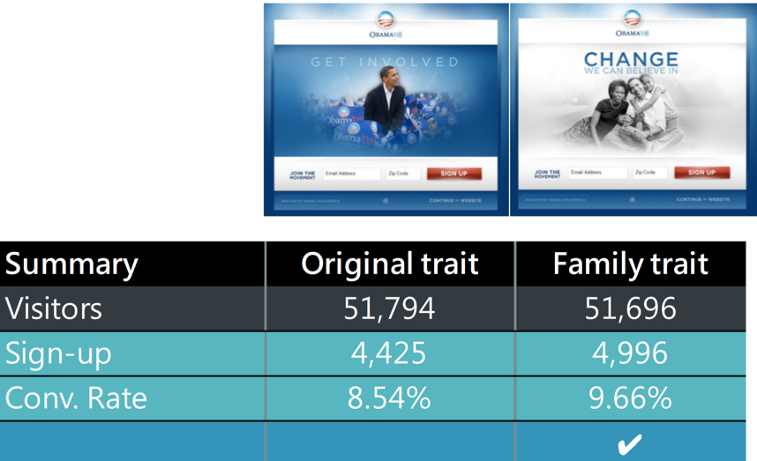
Significance testing
null hypothesis D = (err.null - err.model) == 0
p-value is the probability of null hypothesis
p < 0.05 => reject the null hypothesis

Slide 10
A/B test
Fisher’s test for independence
the null hypothesis : conversion is independent of group , A=B
fisher.test(tab)
Frequentist significance test
assume that A and B come from an identical distribution with a common conversion rate => how likely it would be that the B group scores as high as it did by mere chance!
Practical Data Science with R by Nina Zumel, John Mount

Slide 11
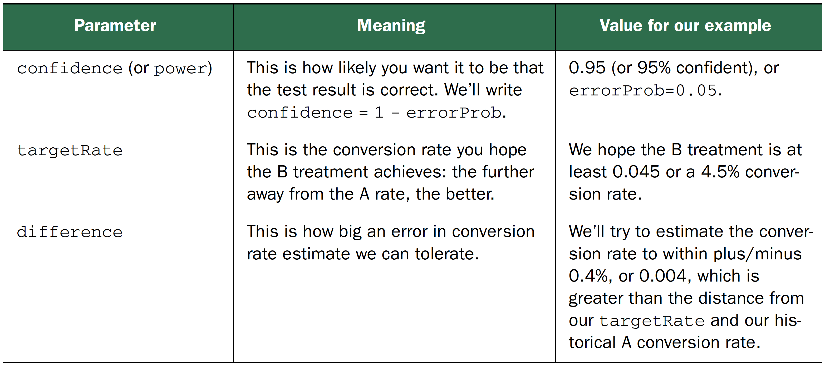
Statistical test power
probability of rejecting the null hypothesis when the null hypothesis is false = 1 - p-value
seeing a B conversion rate in the range of 4.1–4.9% if the true B conversion rate were in fact 4.5% => how many customers to the B treatment?
Practical Data Science with R by Nina Zumel, John Mount

Slide 12
Sample size estimate
estimate <- function(targetRate,difference,errorProb) {
ceiling(-log(errorProb)*targetRate/(difference^2))
}
(est <- estimate(0.045,0.004,0.05))
We need about 8,426 visitors to have a 95% chance of observing a B conversion rate of at least 0.041 if the true unknown B conversion rate is at least 0.045.
Practical Data Science with R by Nina Zumel, John Mount

Slide 13
Design experiments
estimate <- function(targetRate,difference,errorProb)
estimate(0.045,0.004,0.05)
Performance difference vs confidence
measure large performance differences with high confidence
estimate(0.045,0.005,0.04)
measure small performance differences with even moderate confidence.
estimate(0.045,0.003,0.06)
Practical Data Science with R by Nina Zumel, John Mount

Slide 14
Exact binomial sample size calculation
We need about 8,426 visitors to have a 95% chance of observing a B conversion rate of at least 0.041 if the true unknown B conversion rate is at least 0.045.
pbinom(ceiling((0.045-0.04)* 8426), size= 8426, prob=0.045)
The failure odds are around 4% (under the 5% we’re designing for), which means the estimate size was slightly high.
Practical Data Science with R by Nina Zumel, John Mount

Slide 15
Venue shopping reduces test power
multiple tests : if you run 20 treatments, each with a p-value goal of 0.05, you would expect one test to appear to show significant improvement, even if all 20 treatments are useless
p cutoff: p / the # of tests you intend to run
Practical Data Science with R by Nina Zumel, John Mount

Slide 16
Outline
Feature selection
RFE
LIME
Feature extraction
PCA
SVD
CA
PLSA

Slide 17
Feature reduction

Slide 18
Feature reduction
Feature selection
select the most influential features from the feature set => improve the recognition rate as well as reduce the computation load
Feature extraction
find a linear transformation to transform the original feature vector into a new one => maximize the separation between different classes
Credit : Roger Jang (張智星), Data Clustering and Pattern Recognition (資料分群與樣式辨認)

Slide 19
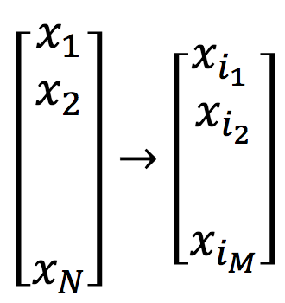
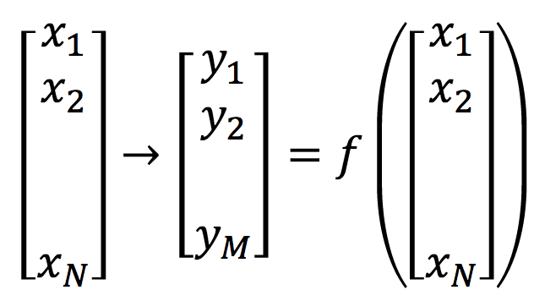
Feature extraction vs. feature selection
Feature selection: Select a subset of the existing features without a transformation
Feature extraction: Transform the existing features into a lower dimensional space
Credit : CSCE 666 Pattern Analysis | Ricardo Gutierrez-Osuna | CSE@TAMU

Slide 20
Feature selection

Slide 21
Feature Selection: Goal & Benefits
Goal
To select a subset out of the original feature set for better prediction accuracy
Benefits
Improve recognition rate
Reduce computation load
Explain relationships between features and classes
Credit : CSCE 666 Pattern Analysis | Ricardo Gutierrez-Osuna | CSE@TAMU

Slide 22
Exhaustive Search
Steps for direct exhaustive search
Use k-nearnest neighboring classifier (KNNC) as the classifier, leave-one-out (LOO) test for R² estimate
Generate all combinations of features and evaluate them one-by-one
Select the feature combination that has the best R².
Credit : CSCE 666 Pattern Analysis | Ricardo Gutierrez-Osuna | CSE@TAMU

Slide 23
Exhaustive Search
Direct exhaustive search
1 input
x1
x2
x3
x4
x5
x1, x2
x1, x3
x1, x4
x1, x5
x2, x3
.
.
.
2 inputs
x1, x2, x3
x1, x2, x4
x1, x2, x5
x1, x3, x4
.
.
.
3 inputs
4 inputs
x1, x2, x3, x4
x1, x2, x3, x5
x1, x2, x4, x5
.
.
.
Credit : CSCE 666 Pattern Analysis | Ricardo Gutierrez-Osuna | CSE@TAMU

Slide 24
Exhaustive Search
Drawback
Time consuming
d features => 2^{d}-1 procedures for performance evaluation
d = 10 ➔ 1023 CV for evaluation
Advantage
The optimal feature set can be identified.
Credit : CSCE 666 Pattern Analysis | Ricardo Gutierrez-Osuna | CSE@TAMU

Slide 25
Exhaustive Search
Characteristics of exhaustive search for feature selection
The process is time consuming, but the identified feature set is optimum.
It’s possible to use classifiers other than KNNC.
It’s possible to use performance indices other than LOO.
Credit : CSCE 666 Pattern Analysis | Ricardo Gutierrez-Osuna | CSE@TAMU

Slide 26
Heuristic search for input selection
One-pass ranking
Sequential forward selection
Generalized sequential forward selection
Sequential backward selection
Generalized sequential backward selection
‘Add m, remove n’ selection
Generalized ‘add m, remove n’ selection
Credit : CSCE 666 Pattern Analysis | Ricardo Gutierrez-Osuna | CSE@TAMU

Slide 27
Sequential Forward Selection
Steps for sequential forward selection
Use KNNC as the classifier, LOO for R² estimate
Select the first feature that has the best R².
Select the next feature (among all unselected features) that, together with the selected features, gives the best R².
Repeat the previous step until all features are selected.
Credit : CSCE 666 Pattern Analysis | Ricardo Gutierrez-Osuna | CSE@TAMU

Slide 28
Sequential Forward Selection
1 input
x1
x2
x3
x4
x5
2 inputs
x2, x1
x2, x3
x2, x4
x2, x5
3 inputs
x2, x4, x1
x2, x4, x3
x2, x4, x5
4 inputs
x2, x4, x3, x1
x2, x4, x3, x5
Credit : CSCE 666 Pattern Analysis | Ricardo Gutierrez-Osuna | CSE@TAMU

Slide 29
Sequential Forward Selection
Advantage
A lot more efficient
d features, we need to perform d(d+1)/2 CV
Drawback
The selected features are not always optimal.
Credit : CSCE 666 Pattern Analysis | Ricardo Gutierrez-Osuna | CSE@TAMU

Slide 30
Use of Input Selection
Common use of input selection
Increase the model complexity sequentially by adding more inputs
Select the model that has the best test RR
Typical curve of error vs. model complexity
Determine the model structure with the least test error
Optimal structure
Error rate
Test error
Training error
Model complexity (# of selected inputs)
Credit : CSCE 666 Pattern Analysis | Ricardo Gutierrez-Osuna | CSE@TAMU

Slide 31
Recursive Feature Elimination (RFE)

Slide 32
Recursive Feature Elimination (RFE)
A good feature ranking criterion is not necessarily a good feature subset ranking criterion.
The criteria estimate the effect of removing one feature at a time on the objective function. They become very sub-optimal when it comes to removing several features at a time, which is necessary to obtain a small feature subset.
This problem can be overcome by using the following iterative procedure:
Train the classifier
Compute the ranking criterion for all features
Remove the feature with smallest ranking criterion
Guyon, I., Weston, J., Barnhill, S. & Vapnik, V. Gene Selection for Cancer Classification using Support Vector Machines. Mach Learn 46, 389–422 (2002).

Slide 33
references
Cai,J. et al. (2018) Feature selection in machine learning: A new perspective. Neurocomputing, 300, 70–79.
Li,J. et al. (2017) Feature Selection. ACM Comput. Surv. (CSUR), 50, 1–45.
=> 重要，甚至有提供 scikit learn package
https://jundongl.github.io/scikit-feature/

Slide 34
How would a given example score differently if it had different attributes?
Local interpretable model-agnostic explanations (LIME) for explaining model predictions

Slide 35
iris example
A dataset of petal (花瓣) and sepal (萼片) measurements for three varieties of iris.
The object is to predict whether a given iris is a setosa based on its petal and sepal dimensions.
4 measurements
sepal length
sepal width
petal length
petal width
3 different species
setosa
versicolor
virginica
Credit by https://www.math.umd.edu/~petersd/666/html/iris_pca.html

Slide 36
Loading the iris dataset : LIME.R
iris <- iris
iris$class <- as.numeric(iris$Species == "setosa")
set.seed(2345)
intrain <- runif(nrow(iris)) < 0.75
train <- iris[intrain,]
test <- iris[!intrain,]
head(train)
## Sepal.Length Sepal.Width Petal.Length Petal.Width Species class
## 1 5.1 3.5 1.4 0.2 setosa 1
## 2 4.9 3.0 1.4 0.2 setosa 1
## 3 4.7 3.2 1.3 0.2 setosa 1
## 4 4.6 3.1 1.5 0.2 setosa 1
## 5 5.0 3.6 1.4 0.2 setosa 1
## 6 5.4 3.9 1.7 0.4 setosa 1
Credit by Chapter 6.3, Practical Data Science with R by Nina Zumel, John Mount

Slide 37
Fitting a XGBOOST model to the iris training data
source("lime_iris_example.R")
input <- as.matrix(train[, 1:4])
model <- fit_iris_example(input, train$class)
Credit by Chapter 6.3, Practical Data Science with R by Nina Zumel, John Mount

Slide 38
Building a LIME explainer from the model and training data
library(lime)
explainer <- lime(train[,1:4],
model = model,
bin_continuous = TRUE,
n_bins = 10)
Credit by Chapter 6.3, Practical Data Science with R by Nina Zumel, John Mount

Slide 39
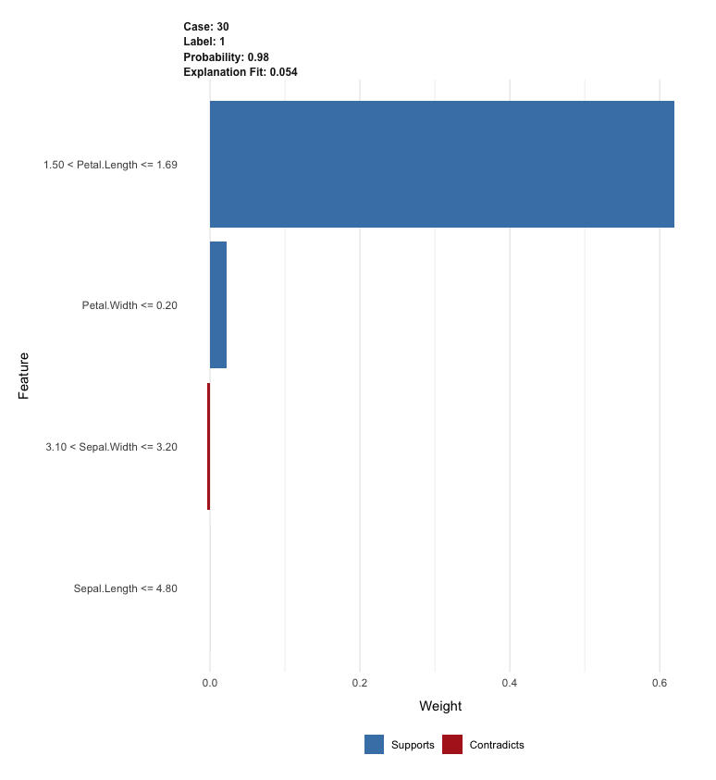
Explaining the iris example
(example <- test[5, 1:4, drop=FALSE])
explanation <- lime::explain(example,
explainer,
n_labels = 1,
n_features = 4)
plot_features(explanation)
Credit by Chapter 6.3, Practical Data Science with R by Nina Zumel, John Mount

Slide 40
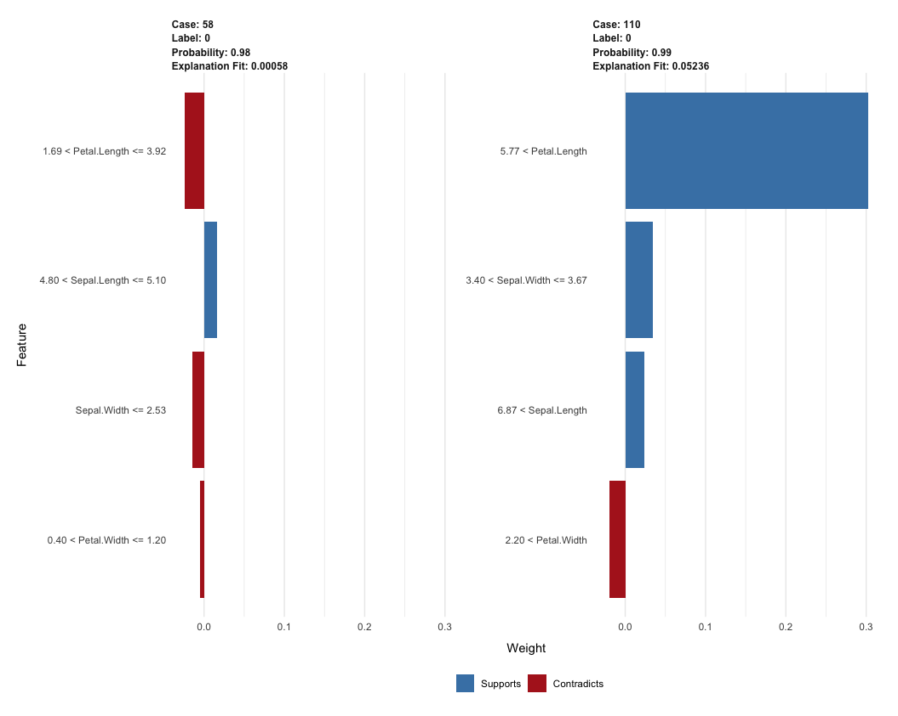
More iris examples
(example <- test[c(13, 24), 1:4])
test$class[c(13,24)]
explanation <- explain(example,
explainer,
n_labels = 1,
n_features = 4,
kernel_width = 0.5)
plot_features(explanation)
Credit by Chapter 6.3, Practical Data Science with R by Nina Zumel, John Mount

Slide 41
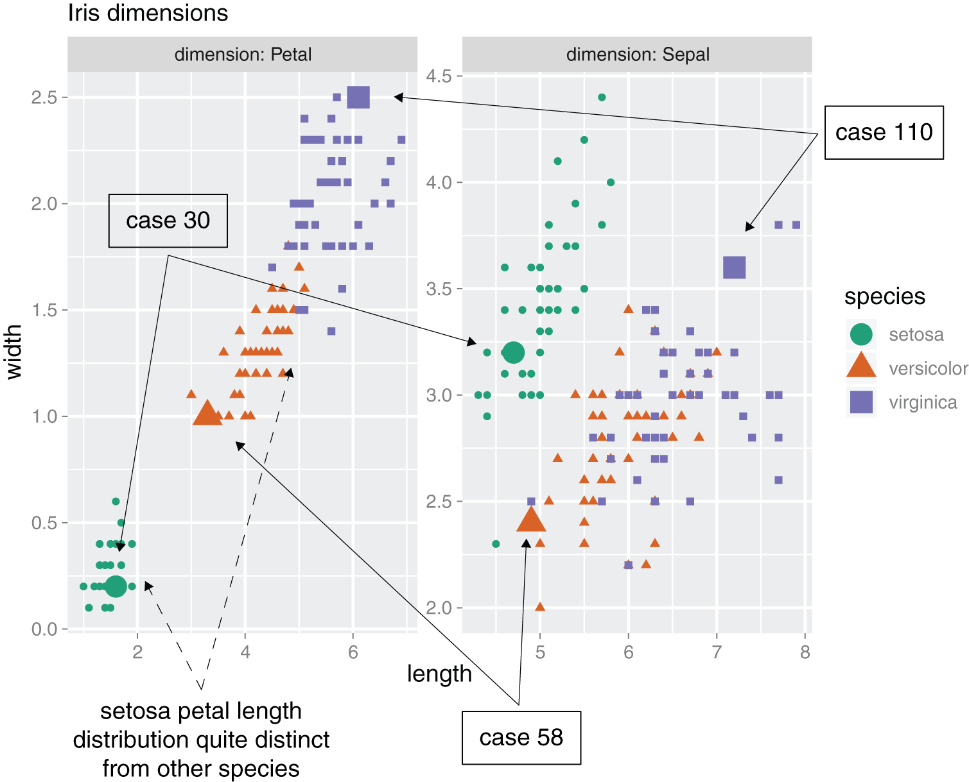
Distributions of petal and sepal dimensions by species
Credit by Figure 6.25, Practical Data Science with R by Nina Zumel, John Mount

Slide 42
How does LIME work?

Slide 43
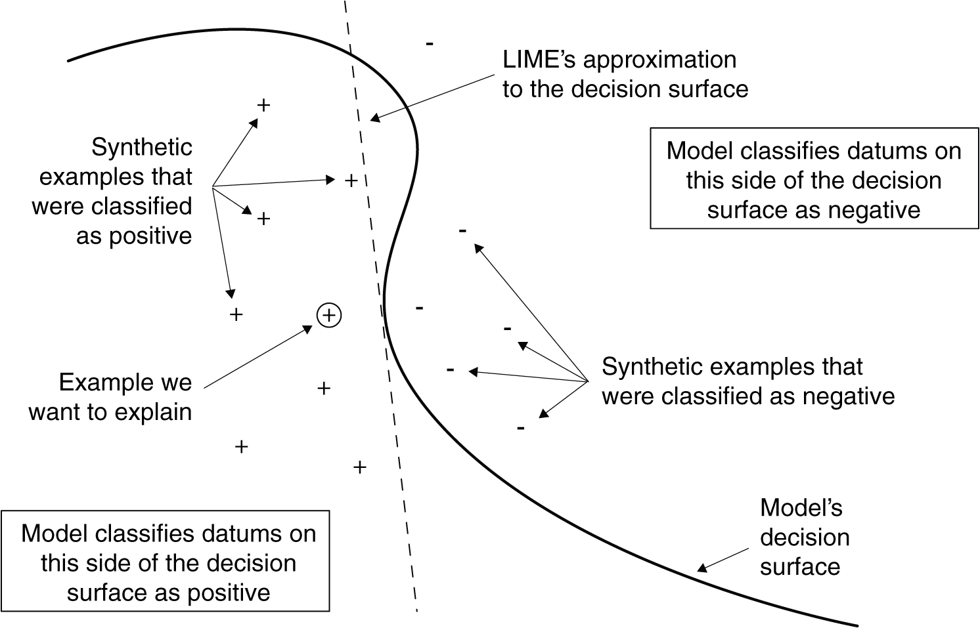
Notional sketch of how LIME works
Credit by Figure 6.23, Practical Data Science with R by Nina Zumel, John Mount

Slide 44
synthetic data points
Original data point
Sepal.Length Sepal.Width Petal.Length Petal.Width
5.1 3.5 1.4 0.2
a jittered point
Sepal.Length Sepal.Width Petal.Length Petal.Width
5.505938 3.422535 1.3551 0.4259682
Credit by Chapter 6.3, Practical Data Science with R by Nina Zumel, John Mount

Slide 45
The model’s decision surface
LIME’s estimate of the decision surface near the example we are trying to explain.
Fit an m-dimensional linear model for {y_{i}} as a function of {s_{i}}. The linear model is LIME’s estimate of the original model’s decision surface near example (a dashed line).
Credit by Chapter 6.3, Practical Data Science with R by Nina Zumel, John Mount

Slide 46
Feature extraction

Slide 47
10. Unsupervised Learning 10.2 Principal Components Analysis

Slide 48
Feature extraction
We wish to visualize n observations with measurements on a set of p features, X₁,X₂, . . ., X_{p}, as part of an exploratory data analysis.
We could do this by examining two-dimensional scatterplots of the data.
A two-dimensional representation of the data that captures most of the information, then we can plot the observations in this low-dimensional space.
An Introduction to Statistical Learning with Applications in R by Gareth James, Daniela Witten, Trevor Hastie, Robert Tibshirani

Slide 49
Feature extraction
a best choice of axes – shows most variation in the data.
Found by linear algebra: Singular Value Decomposition (SVD)
True plot in k dimensions
Reduced-dimensionality plot
Notes:
LSI for dimension reduction
Similar to SVD

Slide 50
Principal Component Analysis (PCA)

Slide 51
topic05-1_PCA.pptx
topic05-1_PCA.pptx

Slide 52
Correspondence Analysis (CA)

Slide 53
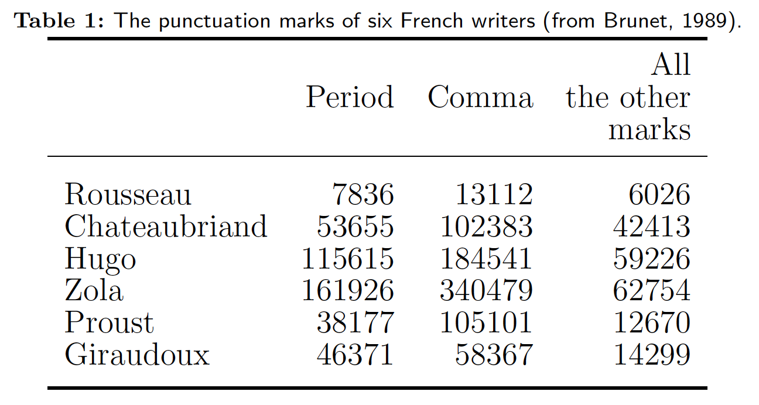
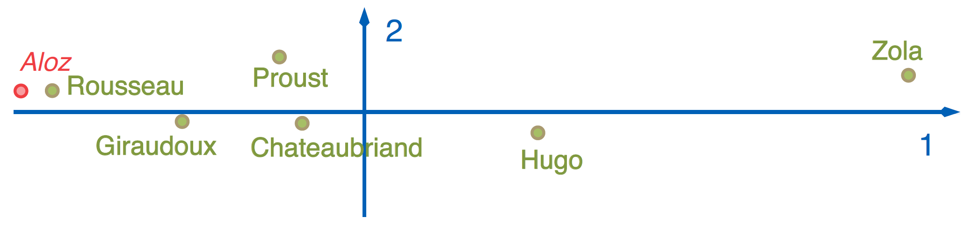
How writers punctuate?
Aloz = [2699 5675 1046]
Credit : HervLe Abdi & Lynne J. Williams, Correspondence Analysis

Slide 54
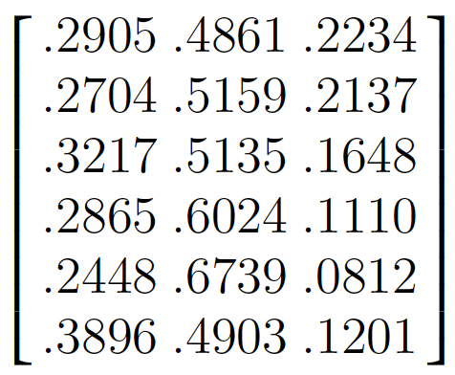
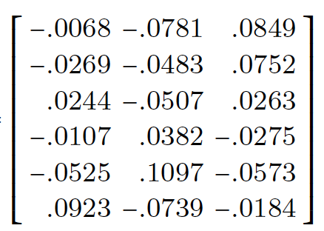
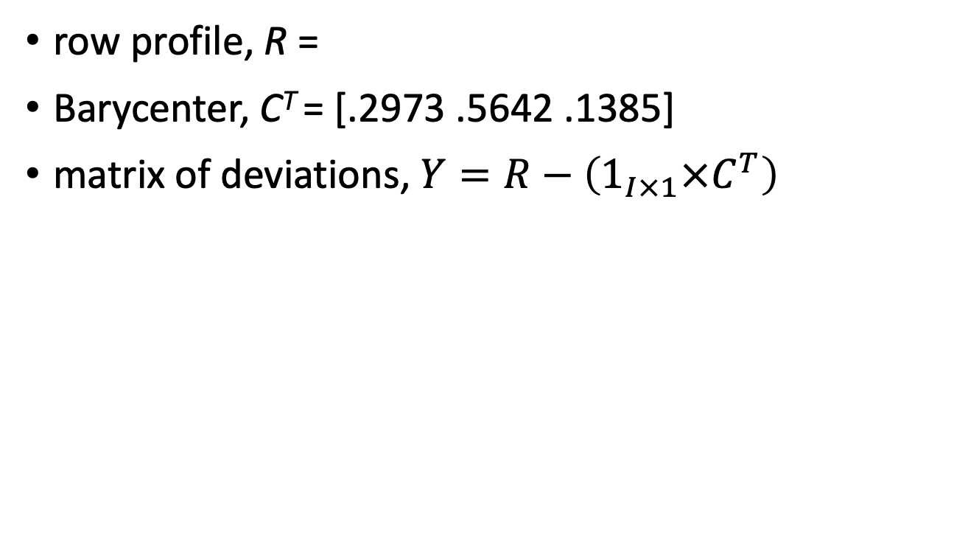
The matrix of deviations
row profile, R =
Barycenter, C^{T} = [.2973 .5642 .1385]
matrix of deviations, $Y=R−\left(1_{I×1}×C^{T}\right)$
Credit : HervLe Abdi & Lynne J. Williams, Correspondence Analysis

Slide 55
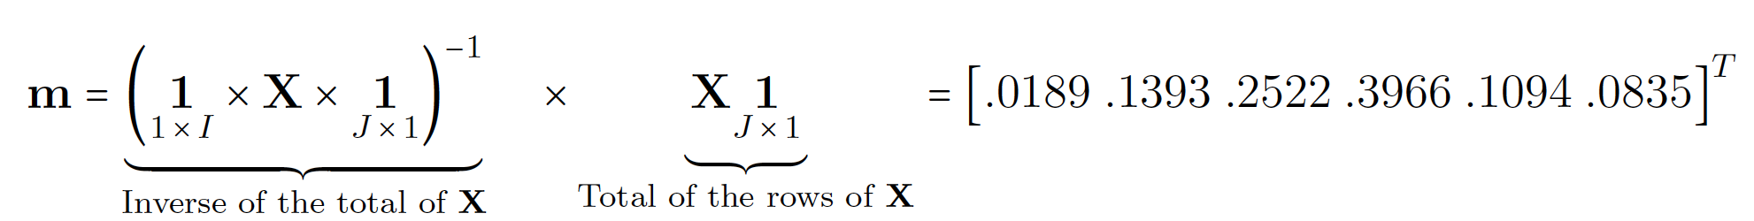
Masses (rows)
the mass of each row is the proportion of this row in the total of the table.
=> The mass of each row reflects its importance in the sample
Credit : HervLe Abdi & Lynne J. Williams, Correspondence Analysis

Slide 56
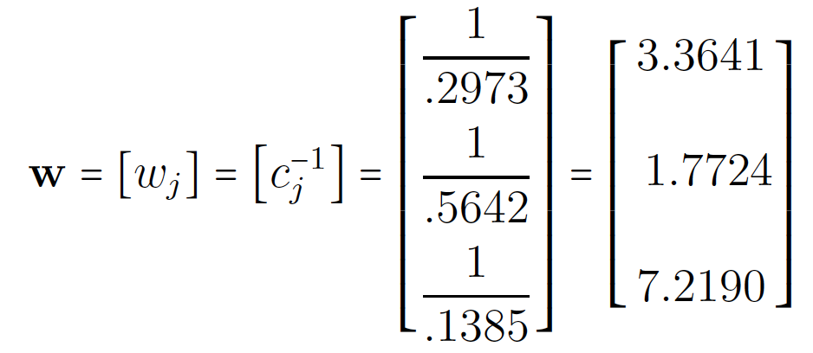
Weights (columns)
The weight of each column reflects its importance for discriminating between the authors.
The idea is that columns that are used often do not provide much information, and columns that are used rarely provide much information.
Credit : HervLe Abdi & Lynne J. Williams, Correspondence Analysis

Slide 57
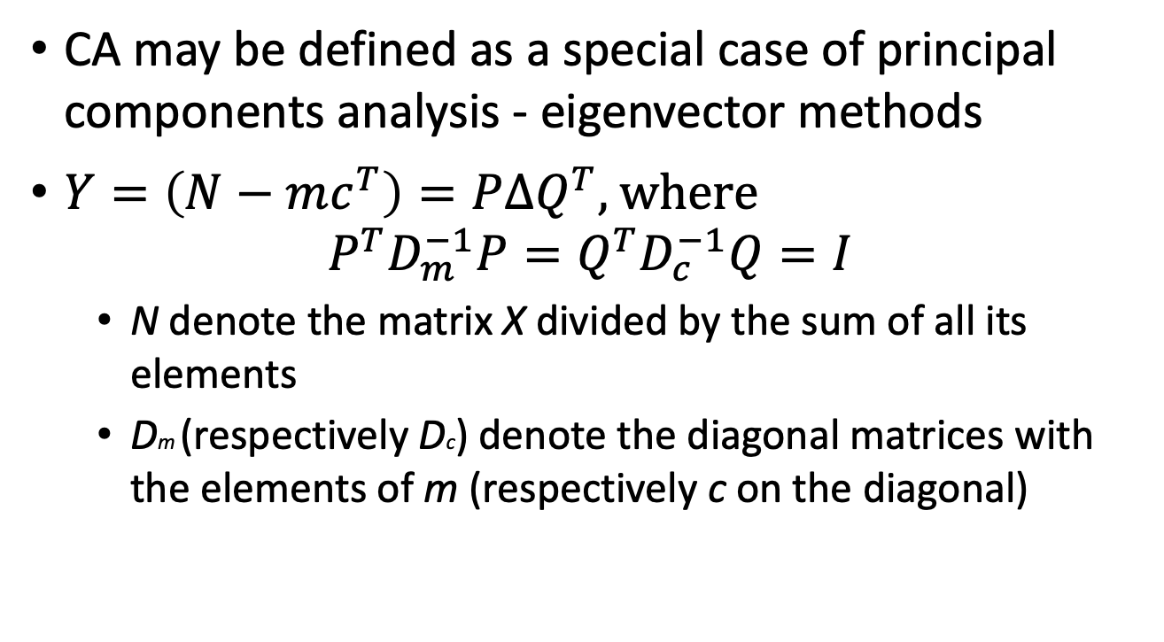
Correspondence analysis (CA)
CA may be defined as a special case of principal components analysis - eigenvector methods
$Y=\left(N−mc^{T}\right)=P∆Q^{T},$ where $P^{T}D_{m}^{−1}P=Q^{T}D_{c}^{−1}Q=I$
N denote the matrix X divided by the sum of all its elements
Dm (respectively Dc) denote the diagonal matrices with the elements of m (respectively c on the diagonal)
Credit : HervLe Abdi & Lynne J. Williams, Correspondence Analysis

Slide 58
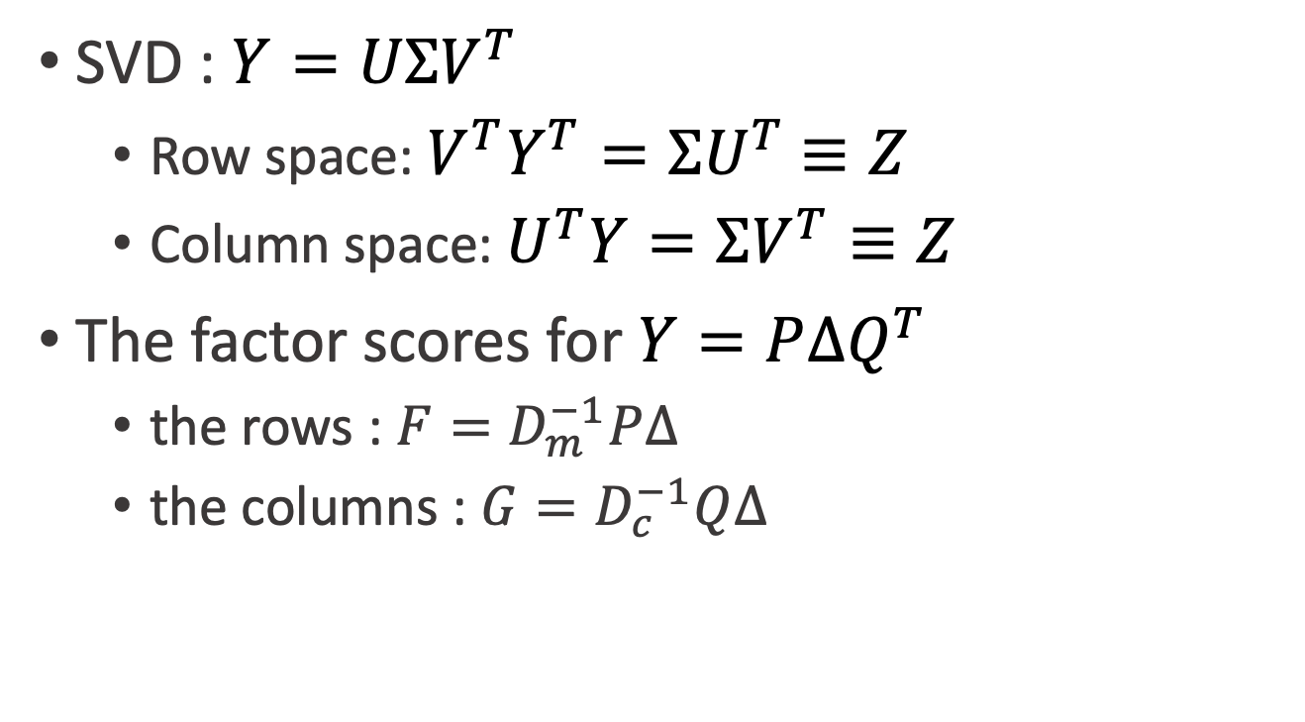
The factor scores for rows and columns
SVD : $Y=UΣV^{T}$
Row space: ${V^{T}Y}^{T}={ΣU}^{T}$ $≡Z$
Column space: $U^{T}Y=ΣV^{T}≡Z$
The factor scores for $Y=P∆Q^{T}$
the rows : ${F=D}_{m}^{−1}P∆$
the columns : $G=D_{c}^{−1}Q∆$
Credit : HervLe Abdi & Lynne J. Williams, Correspondence Analysis

Slide 59
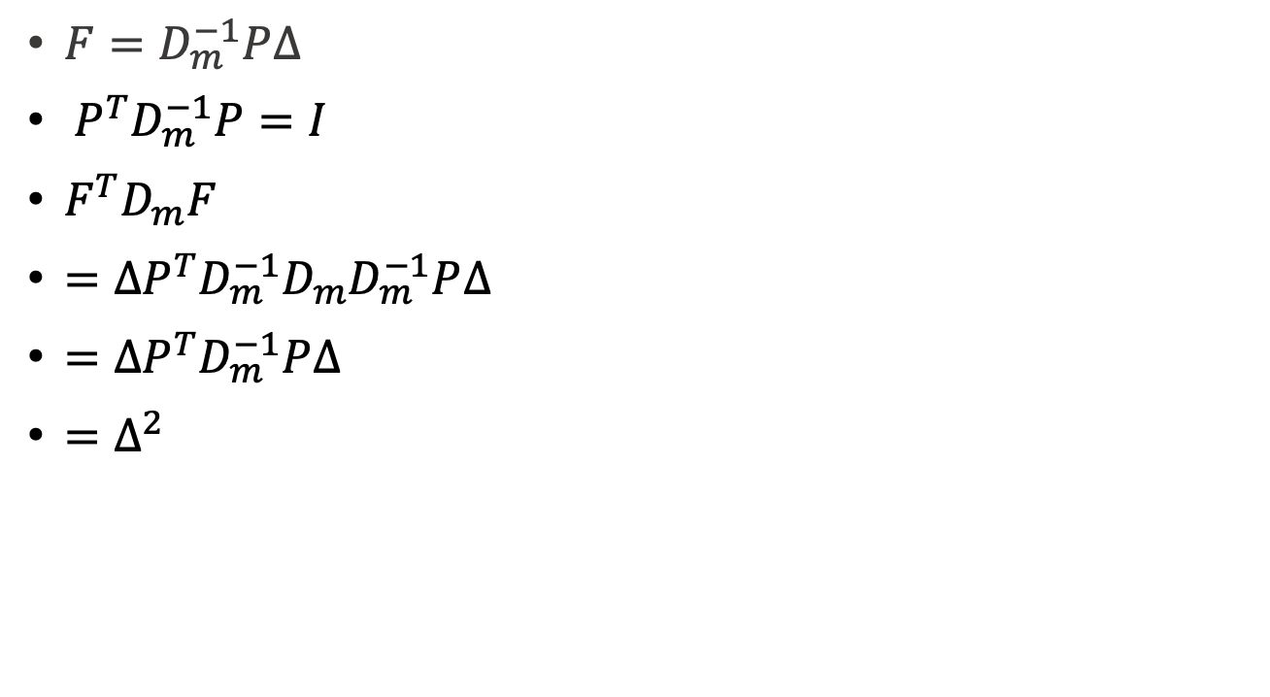
The variance of row factor scores
${F=D}_{m}^{−1}P∆$
${ P}^{T}D_{m}^{−1}P=I$
$F^{T}D_{m}F$
$={∆P^{T}D}_{m}^{−1}D_{m}D_{m}^{−1}P∆$
$=∆P^{T}D_{m}^{−1}P∆$
$=∆^{2}$
Credit : HervLe Abdi & Lynne J. Williams, Correspondence Analysis

Slide 60
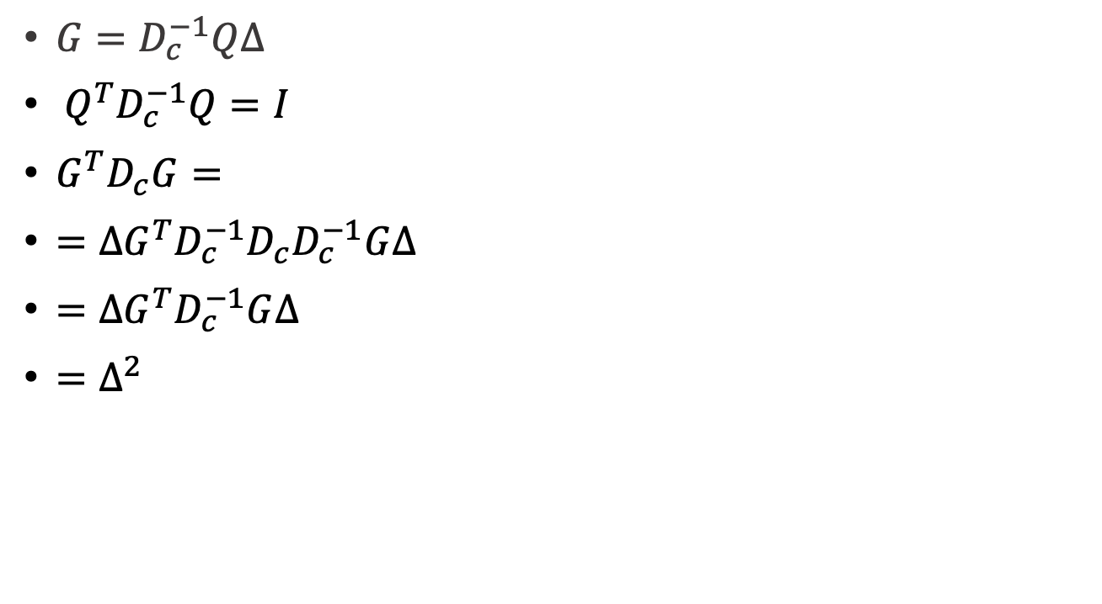
The variance of column factor scores
${G=D}_{c}^{−1}Q∆$
${ Q}^{T}D_{c}^{−1}Q=I$
$G^{T}D_{c}G=$
$={∆G^{T}D}_{c}^{−1}D_{c}D_{c}^{−1}G∆$
$=∆G^{T}D_{c}^{−1}G∆$
$=∆^{2}$
Credit : HervLe Abdi & Lynne J. Williams, Correspondence Analysis

Slide 61
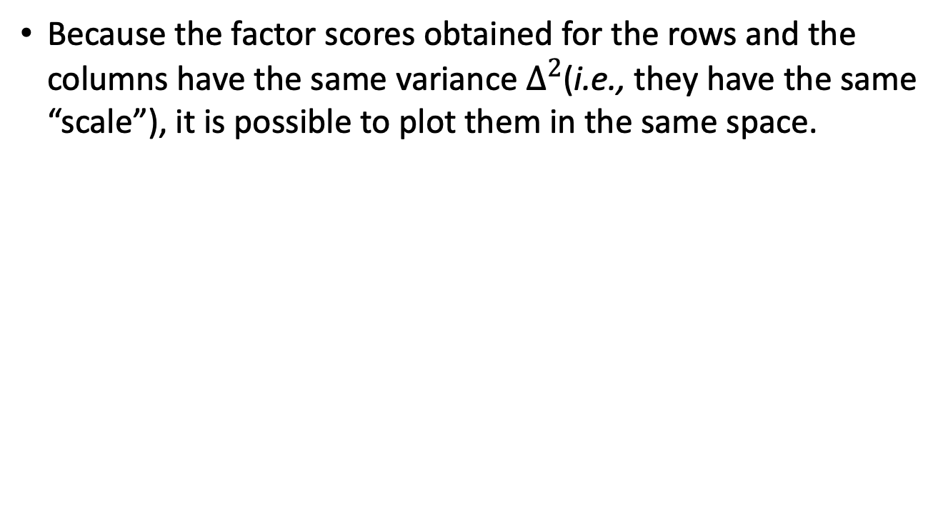
Correspondence analysis
Because the factor scores obtained for the rows and the columns have the same variance $∆^{2}$(i.e., they have the same “scale”), it is possible to plot them in the same space.
Credit : HervLe Abdi & Lynne J. Williams, Correspondence Analysis

Slide 62
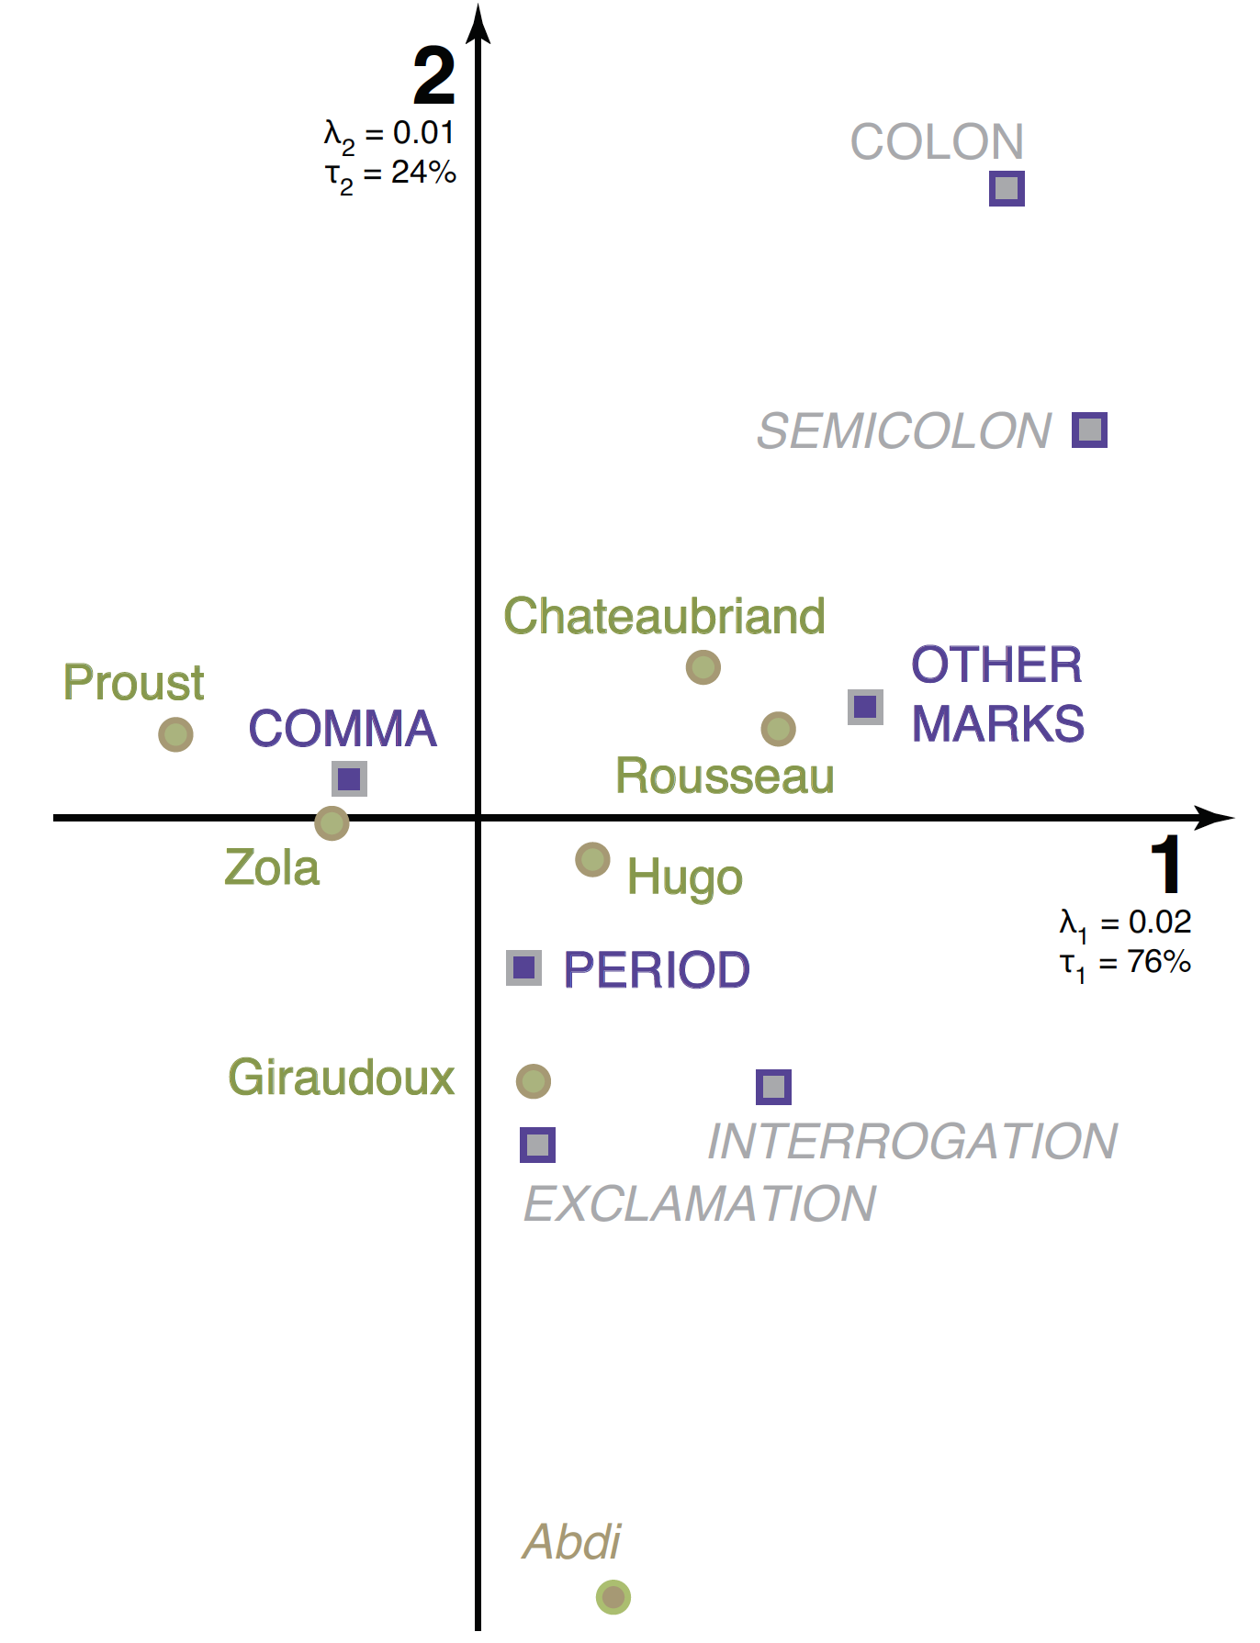
Correspondence analysis of the punctuation of six authors, Comma, Period, and Others
Credit : HervLe Abdi & Lynne J. Williams, Correspondence Analysis

Slide 63
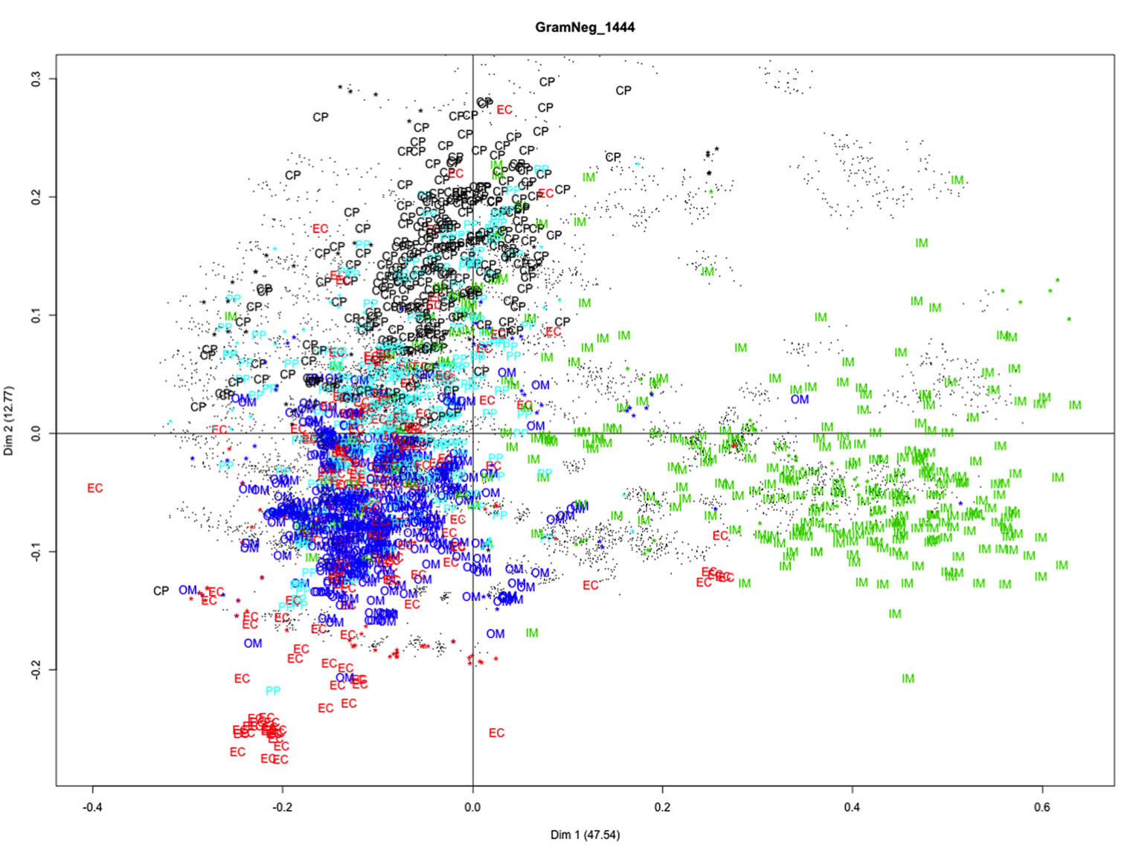
Correspondence analysis of the Gram-negative
IM, OM, CP, EC, PP : proteins
. gapped-dipeptides
* gapped-dipeptide signatures
Chang, J.-M. et al. Efficient and Interpretable Prediction of Protein Functional Classes by Correspondence Analysis and Compact Set elations. Plos One 8, e75542 (2013).

Slide 64
Correspondence analysis provides a graphic method of exploring the relationship between variables in a contingency table.
library(ca)
mytable <- with(mydata, table(A,B)) # create a 2 way table
prop.table(mytable, 1) # row percentages
prop.table(mytable, 2) # column percentages
fit <- ca(mytable)
print(fit) # basic results
summary(fit) # extended results
plot(fit) # symmetric map
plot(fit, mass = TRUE, contrib = "absolute", map =
"rowgreen", arrows = c(FALSE, TRUE)) # asymmetric map
Credit by https://www.statmethods.net/advstats/ca.html

Slide 65
Probabilistic Latent Semantic Analysis

Slide 66
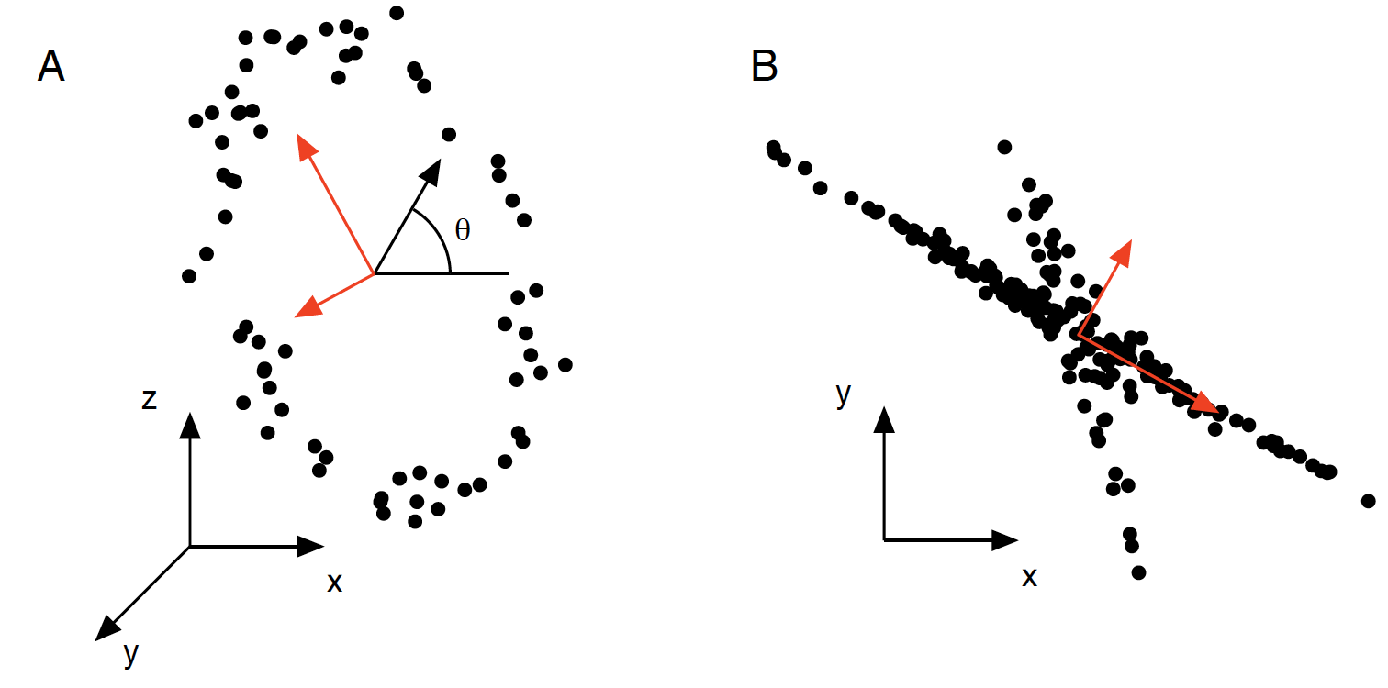
Example of when PCA fails (red lines)
Credit: A Tutorial on Principal Component Analysis, Jonathon Shlens

Slide 67
Weakness of PCA for Classification
Not designed for classification problem (with labeled
training data)
Ideal situation
Adversary situation
Credit : CSCE 666 Pattern Analysis | Ricardo Gutierrez-Osuna | CSE@TAMU

Slide 68
Linear Discriminant Analysis
LDA projection onto directions that can best separate data of different classes.
Adversary situation
for PCA
Ideal situation
for LDA
Credit : CSCE 666 Pattern Analysis | Ricardo Gutierrez-Osuna | CSE@TAMU

Slide 69
Disadvantages of SVD
the resulting dimensions might be difficult to interpret.
{(A0A), (A1A),...,(Z0Z)} -> {1.3x(A0A)-0.2x(B1B),..., (Z0Z)}
the reconstruction may contain negative entries, which are inappropriate as a distance function for count vectors.

Slide 70
Feature Reduction - Probabilistic Latent Semantic Analysis (1/3)
Hofmann T. Unsupervised learning by probabilistic latent semantic analysis. Machine Learn 2001;42:177–196.

Slide 71
Feature Reduction - Probabilistic Latent Semantic Analysis (2/3)
A joint probability between a term w and a document d can be modeled as:
Latent variable z
(“small” #states)
Concept expression
probabilities
Document-specific
mixing proportions
The parameters could be estimated by maximum-likelihood function through EM algorithm.

Slide 72
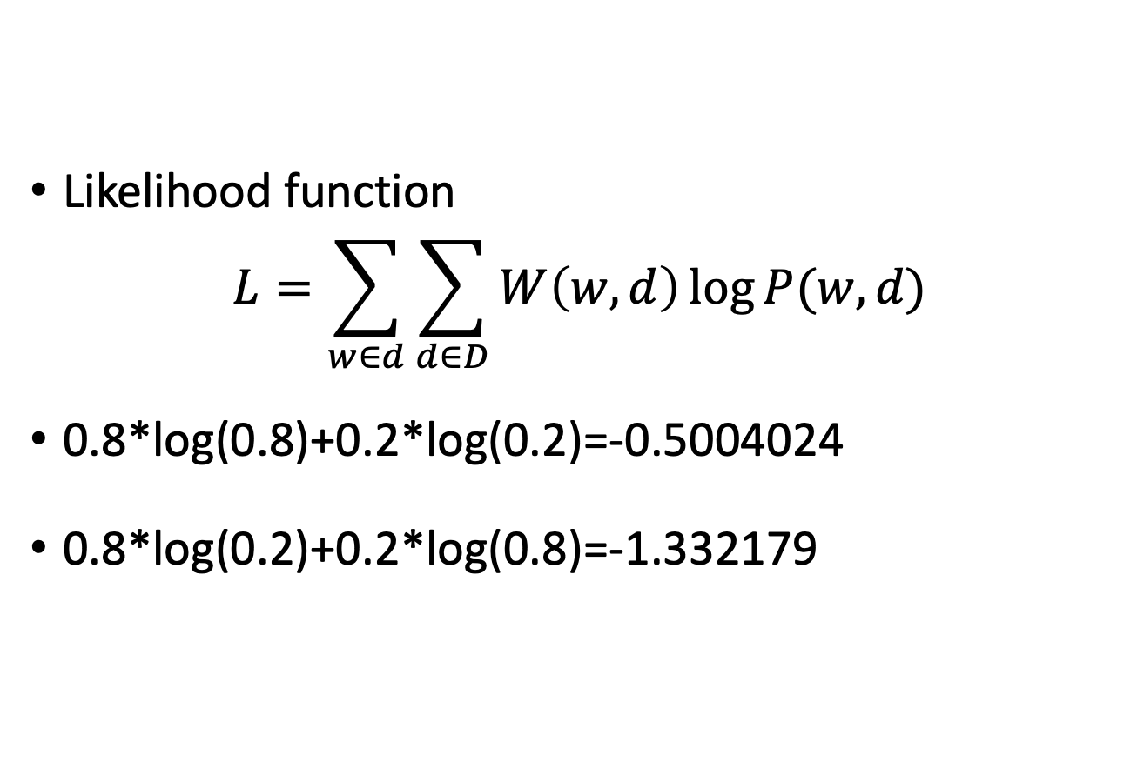
PLSA model fitting
Likelihood function
$$L=\sum_{w∈d}{\sum_{d∈D}{W\left(w,d\right)\log{P(w,d)}}}$$
0.8*log(0.8)+0.2*log(0.2)=-0.5004024
0.8*log(0.2)+0.2*log(0.8)=-1.332179

Slide 73
Maximum Likelihood
Probability vs Likelihood https://youtu.be/pYxNSUDSFH4
Maximum Likelihood https://youtu.be/XepXtl9YKwc

Slide 74
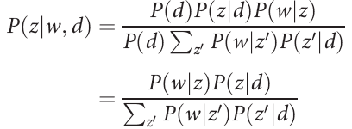
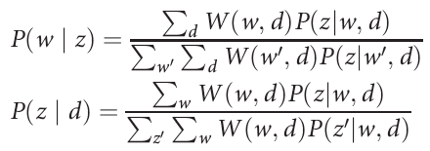
PLSA model fitting
E-step
the probability that a term w in a particular document d explained by the class corresponding to z
M-step

Slide 75
Feature Reduction - Probabilistic Latent Semantic Analysis (3/3)

Slide 76


Thank You Any Question?

